Slide 1
Chapter 3
Fundamentals of Software Maintenance

Slide 2
Overview
Categories of Software Maintenance
  Corrective (Design error, Logical error, coding error)
  Preventive (code restructuring, refactoring etc)
  Perfective (new functionality)
  Adaptive (hardware software changes)
Relationship between Maintenance Categories
Ongoing support
  Effective Communication, Training End User, and Provide business information
Predicting Maintenance
Change Management
Program Evolution Dynamics
  Lehman’s Laws
    Continuing Change
    Increasing Complexity
    Self Regulation
    Conservation of Organizational Stability
    Continuing growth
    Declining Quality
    Feedback system

Slide 3
Categories of Software Maintenance
There are four types of changes in software maintenance.
Corrective
Adaptive
Perfective
Preventive

Slide 4
Corrective Maintenance
Def: Modification initiated by defects are known as corrective maintenance of software.
A defect can result from following errors:
Design errors: These occur when, for example, changes made to the software are incorrect, incomplete, wrongly communicated or the change request is misunderstood.
Logic errors: These result from invalid tests and conclusions, incorrect implementation of design specifications, faulty logic flow or incomplete testing of data.
Coding errors: These are caused by incorrect implementation of detailed logic design and incorrect use of the source code logic. Defects are also caused by data processing errors and system performance errors.
All these errors, sometimes called 'residual errors' or 'bugs', prevent the software from conforming to its agreed specification.

Slide 5
Corrective Maintenance
Software Patch: A software patch or fix is a quick-repair job for a piece of programming designed to resolve functionality issues, improve security and add new features.
This approach gives rise to a range of problems that include increased program complexity and unforeseen ripple effects. It thus leads to spaghetti syndrome.
Spaghetti syndrome: Degeneration of program structure which makes the program increasingly difficult to understand. It also indicates the resistance of the program to change is at its maximum

Slide 6
Adaptive Maintenance
Def: a change driven by the need to accommodate modifications in the environment of the software system.
Environment refers to the totality of all conditions and influences which act from outside upon the system i.e: business rules, government policies, work patterns, software and hardware operating platforms.
Includes any work initiated as a consequence of moving the software to a different hardware or software platform - compiler, operating system or new processor.
Example: upgrading systems for new OS versions (e.g., Windows/macOS), updating APIs, adapting to new data privacy laws, or migrating to cloud services.

Slide 7
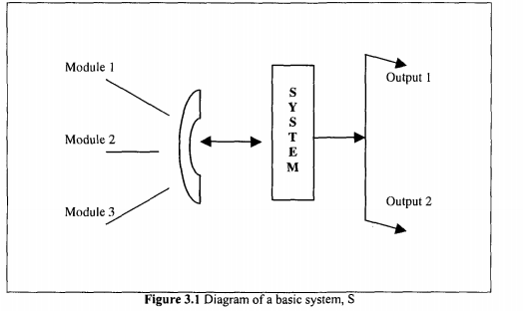
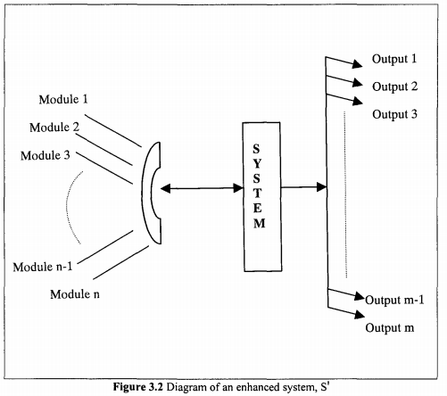
Perfective Maintenance
Def: is the process of updating, enhancing, and refining software after its release to improve performance, maintainability, or user experience, rather than fixing bugs.

Slide 8
Preventive Maintenance
Def: involves taking measures to prevent future problems, such as optimization, updating documentation, reviewing and testing the system, and implementing preventive measures such as backups.
Example: include refactoring code to improve readability, updating libraries to avoid security risks, and updating documentation to reflect architectural changes

Slide 9
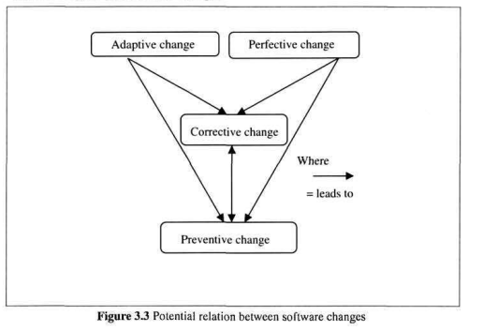
Relationship Between Maintenance Categories

Slide 10
Ongoing Support
Def: This category of maintenance work refers to the service provided to satisfy non-programming-related work requests.
It does not create software change, but is essential for successful communication of desired changes.
Followings are some of the ongoing support activities:
  Effective communication: Maintenance is the most customer-intensive part of the software life-cycle. It is necessary to establish good customer relations and cooperation, and continually demonstrate that they aim to satisfy the customers
  Training of end-users: Training refers to the process of equipping users with sufficient knowledge and skills to enable them use a system to its full potential.
  Providing business information: Users need various types of timely and accurate information to enable them take strategic business decisions.

Slide 11
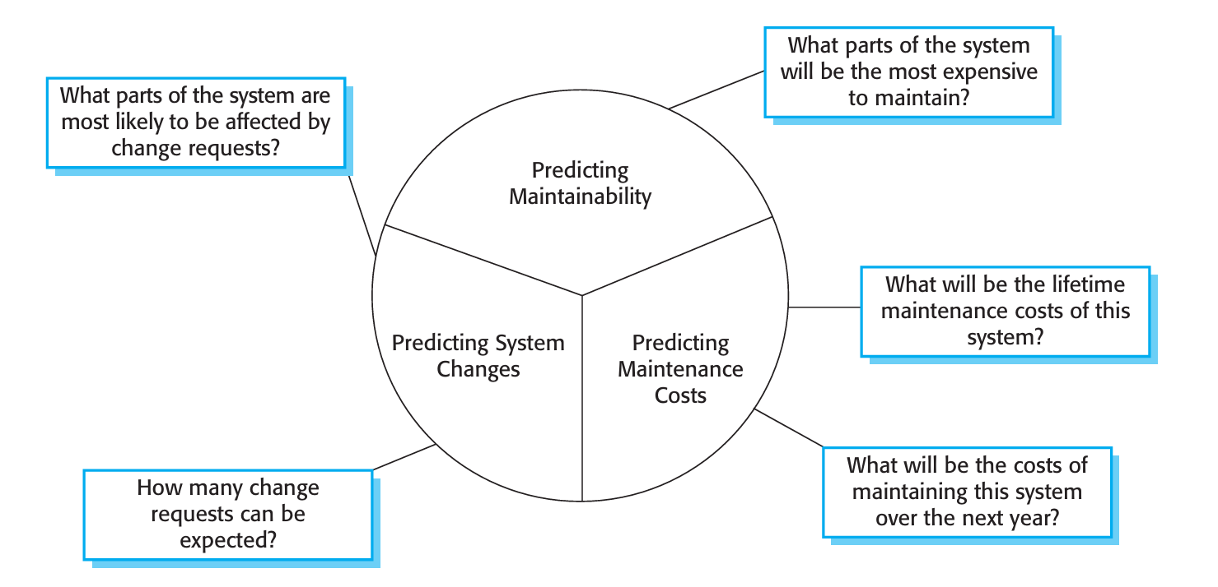
Maintenance Prediction
Chapter 9: Software Evolution
Book: SOFTWARE ENGINEERING - Ian Sommerville
Predict what system changes might be proposed and what parts of the system are likely to be the most difficult to maintain.
Estimate the overall maintenance costs for a system in a given time period.

Slide 12
Predicting the number of change requests
Requires an understanding of the relationship between the system and its external environment.
Some systems have a very complex relationship with their external environment and changes to that environment inevitably result in changes to the system.
To evaluate the relationships between a system and its environment:
  The number and complexity of system interfaces: The larger the number of interfaces and the more complex these interfaces, the more likely it is that interface changes will be required as new requirements are proposed.
  The number of inherently volatile system requirements: Requirements that reflect organizational policies and procedures are likely to be more volatile than requirements that are based on stable domain characteristics.
  The business processes in which the system is used As business processes evolve, they generate system change requests. The more business processes that use a system, the more the demands for system change.

Slide 13
Predicting Maintainability
It is not surprising that the more complex a system or component, the more expensive it is to maintain.
Complexity measurements are particularly useful in identifying program components that are likely to be expensive to maintain.
To reduce maintenance costs, you should try to replace complex system components with simpler alternatives.
  Number of requests for corrective maintenance: An increase in the number of bug and failure reports may indicate that more errors are being introduced into the program than are being repaired during the maintenance process. This may indicate a decline in maintainability.
  Average time required for impact analysis: This reflects the number of program components that are affected by the change request. If this time increases, it implies more and more components are affected and maintainability is decreasing.
  Average time taken to implement a change request: The amount of time that you need to modify the system and its documentation, after you have assessed which components are affected. An increase in the time needed to implement a change may indicate a decline in maintainability.
  Number of outstanding change requests An increase in this number over time may imply a decline in maintainability.

Slide 14
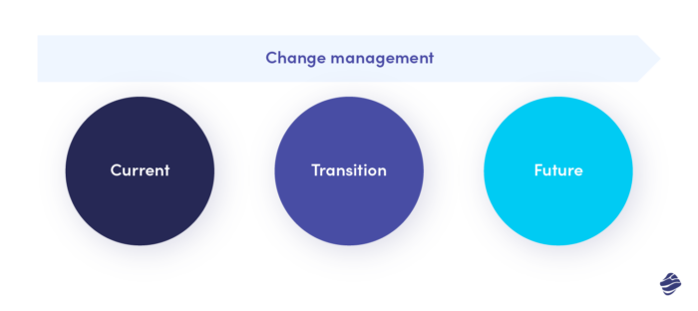
Change Management
Change management in software projects is the process of transiting from the current defective state to the improved state.

Slide 15
Reasons to Change
The project requirements have changed.
Some bugs need fixing.
Some team members have left the project.
Your company has been reorganized.
Market demands have shifted.
Project performance requires some improvements.

Slide 16
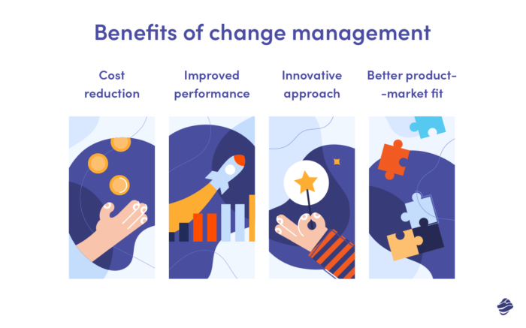
Benefits of Change Management

Slide 17
Types of Change Management
Anticipatory change: When we know in advance that a certain change or series of changes is bound to happen. Such planned shifts are significantly easier to implement as here, the project manager has time to tackle the expected situation.
Incremental change: The changes in projects that happen relatively often and gradually. They don’t involve immense shifts that turn the entire project on its head. Instead, the changes are introduced progressively and often may not be noticeable at first glance.
Emergency (or urgent) change: The changes that need to be introduced immediately. Otherwise, the project may become a failure or its execution may be impossible.
Reactive change: Shifts that occur due to an event or a series of events. They often happen when least expected. For that reason, reactive changes are particularly challenging to manage as, in most cases, they can’t be planned in advance.
Strategic change: They involve the whole organization and result from the decisions of C-level management.

Slide 18
Tools for Conducting Change Management
Wrike
The Change Compass
JIRA
Trello
The Change Shop

Slide 19
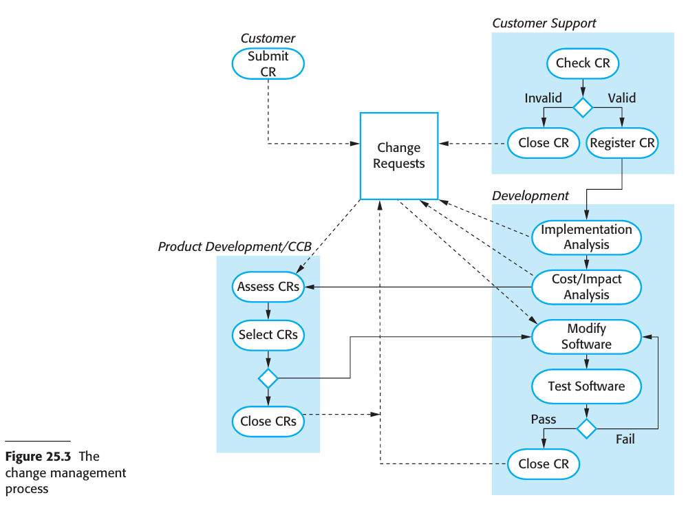
Change Management Steps

Slide 20
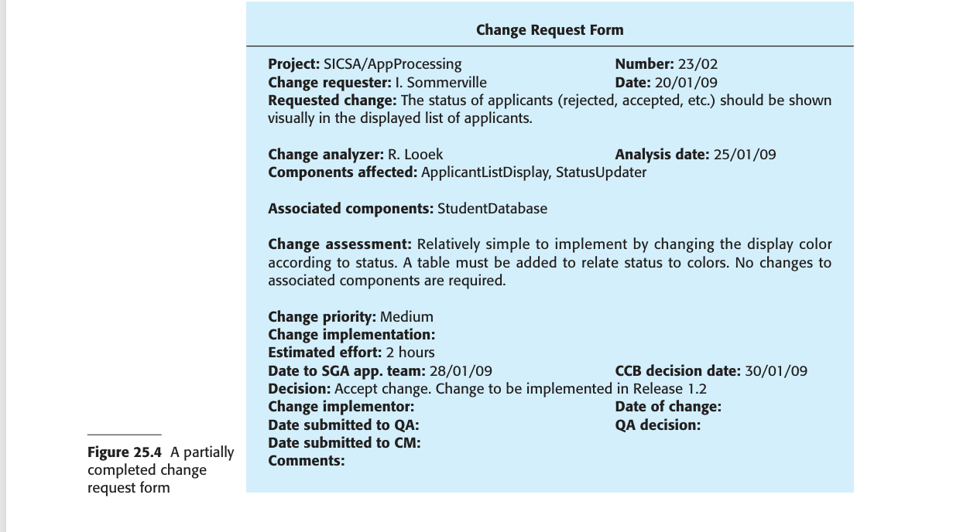

Slide 21
Factors on deciding on change approval
Significant factors that should be taken into account in deciding whether or not a change should be approved are:
The consequences of not making the change
The benefits of the change
The number of users affected by the change
The costs of making the change
The product release cycle

Slide 22
References
https://www.miquido.com/blog/change-management-in-software-development/
Chapter 25: Software Engineering – Ian Sommerville

Slide 23
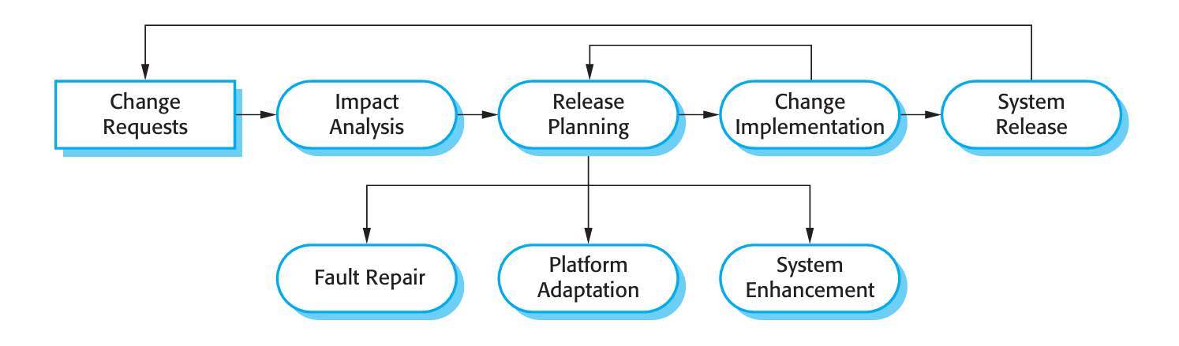
Software Evolution Process

Slide 24
Program evolution dynamics
Program evolution dynamics is the study of system change.
Lehman and Belady (1985) carried out several empirical studies of system change with a view to understanding more about characteristics of software evolution.
The work continued in the 1990s as Lehman and others investigated the significance of feedback in evolution processes (Lehman, 1996; Lehman et al., 1998; Lehman et al., 2001).
From these studies, they proposed ‘Lehman’s laws’ concerning system change.

Slide 25
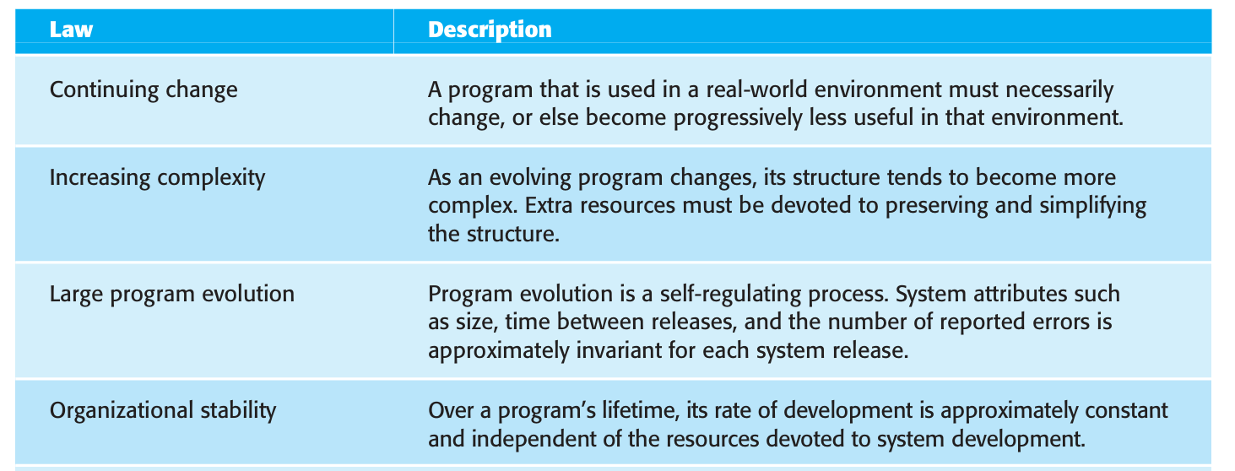
Lehman's Laws

Slide 26
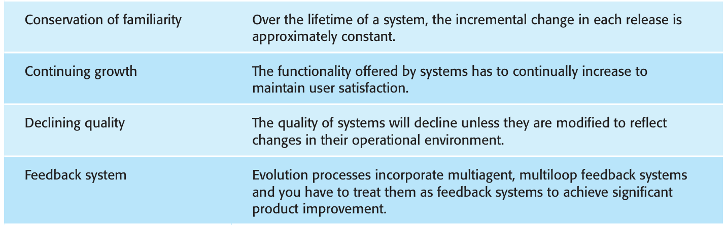
Lehman's Laws

